Slide 1
Establishing a business process
Business Intelligence & Analytics

Slide 2
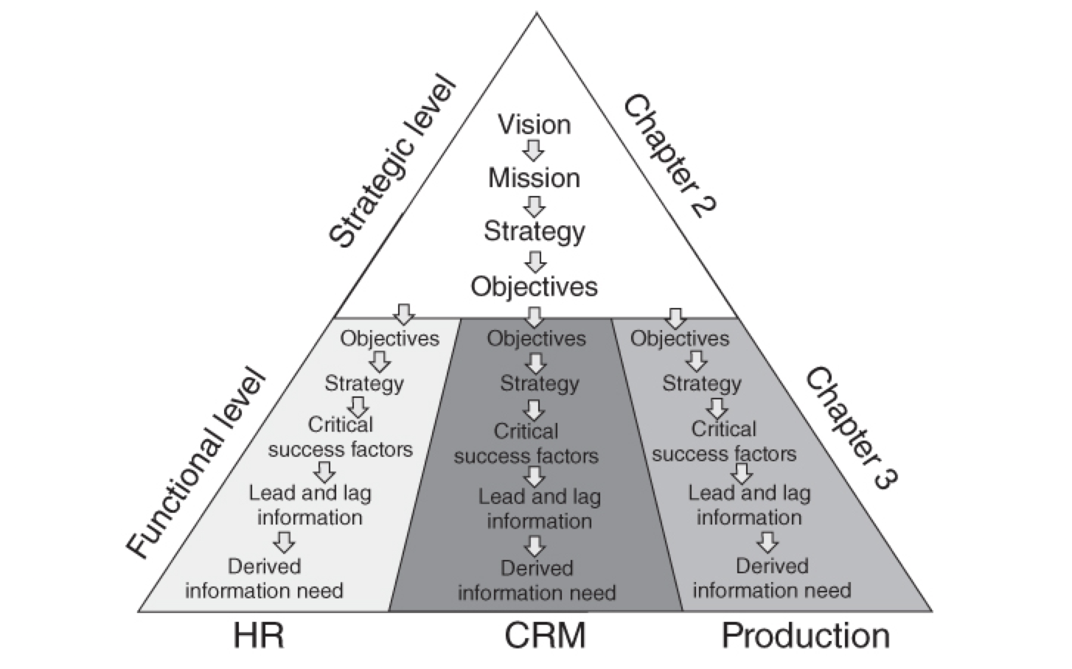

Slide 3
Corporate Strategy
Large telecom marketing dept
Dept Strategy
Responsible for retention and cross-sell
Required to increase # of customers and average revenue
New Initiative
Retain top third of customer base
Cross-sell to existing customers to gap fill
Targets at company level

Slide 4
Corporate Strategy
Large telecom marketing dept
Dept Strategy
Responsible for retention and cross-sell
Required to increase # of customers and average revenue
New Initiative
Retain top third of customer base
Cross-sell to existing customers to gap fill
Targets at company level
Level 1: Identify Objectives

Slide 5
Corporate Strategy
Large telecom marketing dept
Dept Strategy
Responsible for retention and cross-sell
Required to increase # of customers and average revenue
New Initiative
Retain top third of customer base
Cross-sell to existing customers to gap fill
Targets at company level
Level 1
Objectives
Level 2
Operational
Strategy

Slide 6
Target breakdown
Notes:
10% increase on top third will result in 5% avg revenue. 3% is normal so we need 2% for cross-sell

Slide 7
Critical success factors
Elements of the plan that must have a successful outcome if the plan as a whole is to succeed
If just one of the success factors fails, the whole strategy is expected to fail meaning our objectives will not be met

Slide 8
Success factors for our project
Retain 10% more of top third
Suggest the right retention offer at the right time
Add 2% in additional revenue via cross-sell
Suggest the right cross-sell offer at the right time (to the right people)
Level 3
Critical success
factors

Slide 9
Identify lead & lag information
Level 4
Identify information
Retention Project
Cross-sell Project
Lead information
Which customers are leaving?
When?
Why?
Lag information
Monitor progress of campaign
Lead information
Which customers might want to buy?
When?
Lag information
Monitor progress of campaign
Notes:
Will leave the determination of lag information to after ops have been worked out

Slide 10
Different types of information
Strategic Information
Definition: Information that would be used to create a digital marketing strategy.
Example: Should sales turnover be supported through new customer acquisition, selling more to existing customers or focusing on customer retention?
More generally: What should we do?
Tactical Information
Definition : Creation and optimization of new/existing campaigns.
Example: Who should receive this campaign? When should we introduce it? Should the campaign be time limited?
More generally: How should we do it?
Operational Information
Definition : Concrete information that will drive action against campaigns.
Example: Which customers should we contact and which offers should be made?
More generally: Now we do it.

Slide 11
Used this example to breakdown the steps to creating a new initiative
Defined critical success factors
Determined which data need to support those success factors
Discussed different levels of information needed to execute the initiative

Slide 12


